Slide 1

Average Cost of Undergraduate Education in the USA

Slide 2
Data Analysts:
Anthony Pino
Debra Mcnulty
Nema Aragones
Robert Bellgraph

Slide 3

This research study will answer the following questions:
Which 5 states had the lowest & highest average tuition fees in a public out-of-state institution year 2021
Which 5 states had the lowest & highest average tuition fees in a public out-of-state type institution year 2019
What the average percentage tuition increase in tuition cost in a public out-of-state type institution year 2019 – 2021
Does tuition increase every year?
Can one afford to get a 4 year undergraduate degree with a budget of $10000 per year on expenses (tuition & room/board)
What type of institution would one go to on a tight budget to pursue an undergraduate education?
What’s the average 4 year undergraduate cost of a private institution?
Notes:
Research Questions to Answer:
Plot 2019 - We start off with 1st question that was during the pandemic (COV-19), what’s the education cost during a pandemic time. Then we’re gonna compare that with the next slide.
----------------------
What’s the:
Where in the US can a family find the most Affordable education for a four-year undergrad education.
We present in out mapping both Privat and Public. 2 year and 4 year
2 year and 4 year
Can we see a true variance from the Covid Pandemic
Is Public In State or Out of Sate or Private schools more economical.
****** POSSIBLE NEEDS*****
2021 Bar - can we add color to the highest 5 and lowest and possibly add the dollars in the ends
Possible top by themselves
Questions on Data:

Slide 4
This research study will answer the following questions:
Average Cost for a 4 year Public Education based on Tuition 2021 -- Chart completed
Average Cost for a 2 year Public Education based on Tuition 2021 -- Chart completed
State Cost comparison of 2 and 4 year Public -- Chart completed Can we add the dollar to the top of the chart bars if they are not there.
Avg cost of Private on a 4 year education based on tuition 2021 -- Chart completed Data not available for Private 2 year tuition
State Cost comparison of private and public education. for 2021 -- chart completed.
------------NEMA Suggestions
Average price at all ranked private colleges for school year 2021 – 2022 --- included in Anthony
Average price increase during a five year period (is it rising by how much %) NEED -- Nema
Average price at all ranked private colleges for school year 2020 and 2021 NEED -- Nema
Average price increase during a five year period (If interested to go in out-of-state at ranked public schools:) NEED -- Robert
Average price at all ranked private colleges for school year 2020 and 2021 NEED – Robert ** still would like to get but will need help
Looking for type of school (private / public-in-state/ public-out-state) Do they off all the same benefit?? Extra credit
Did COVID-19 has an effect on the fees (can we ask if we can the affect covid by looking to see if the average before 2021 was inline with the standard increase from year to year prior to 2019 ) Extra Credit Above or below trending line
CHARTS NEEDED: heat map for cost per state. API ANTHONY
ORIGINAL Top 5 best schools for funding (most expensive) /year
Top 5 best schools for funding (most expensive) by state /year -- Deb
Top 5 lowest schools for funding (least expensive) /year
Top 5 lowest schools for funding (least expensive) by state/year Looking for schools by state within specific ranges (small, med, large)
Notes:
Research Questions to Answer:

Slide 5
All Plots present: ****** Not part of Presentation ********
2019 Average Fees/Tuition Cost of a 4 Year Public Education
2021 Average Fees/Tuition Cost of a 4 Year Public Education
2019/2021 State Cost Comparison 4 year public education
2019 Average Fees/Tuition of a 2 Year Public Education
2021 Average Fees/Tuition of a 2 Year Public Education
2019/2021 State Cost Comparison 2 year public education
2021 State Cost Comparison of a 2 and 4 Year Public Education
2021 Average Fees/Tuition Cost of a Private Education
2021 State Cost Comparison of a Private and Public Education
Undergraduate average cost per type of institution
Average Cost by year trend
Tuition By School Type
Tuition By State
Distribution of Institutions By Sector
Distribution of Institutions By Type
5 Year Tuition Avg By State
Total Cost by Year for All Schools
Total Cost by Year for Private Schools
Total Cost by Year – In State
Total Cost by Year – Out of State
Display the ff.:
2021 Map of Fees/Tuition per state (Public 4-Year)
2021 Map of Fees/Tuition per state (Private 4-Year)
Notes:
Research Questions to Answer:

Slide 6
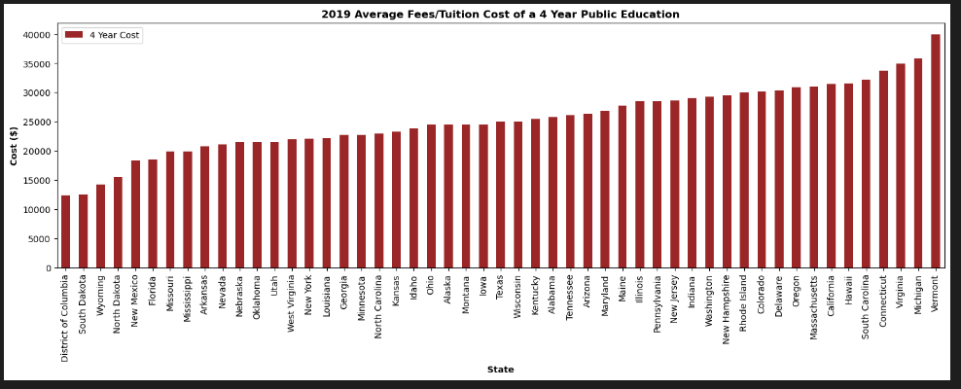
2019 Average Fees/Tuition Cost of a 4 Year Public Education
Analysis: There’s a difference of $27,531 between the highest and lowest avg tuition which is a 221.74% increase cost from the lowest to the highest in tuition in an out-of-state of a 4 year public education in 2019.
Five cheapest states for a 4 year public education (2019) 1.District of Columbia ($12,416) 2.South Dakota ($12,465) 3.Wyoming ($14,268) 4.North Dakota ($15,565) 5.New Mexico ($18,350)
Five most expensive states for a 4 year public education (2019) 1.Vermont ($39,947) 2.Michigan ($35,844) 3.Virginia ($ 34,8900) 4.Connecticut($33,709) South Carolina ($32174)

Slide 7
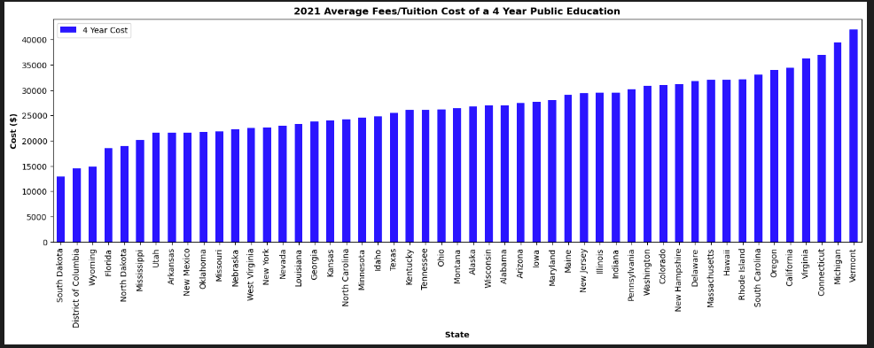
Analysis:
There’s a difference of $29,039 between the highest and lowest avg tuition which is a 224.69% increase cost from the lowest to the highest in tuition state of a 4 year public education in 2021.
Five most cheapest states for a 4 year public education 1.South Dakota ($12,924) 2.District of Columbia ($14,540) 3.Wyoming ($14,803) 4.Florida ($18,514) 5.North Dakota ($19,021)
Five most expensive states for a 4 year public education 1.Vermont ($41,963) 2.Michigan ($39,427) 3.Connecticut($36,881) 4.Virginia ($36,193) California ($34,398)

Slide 8
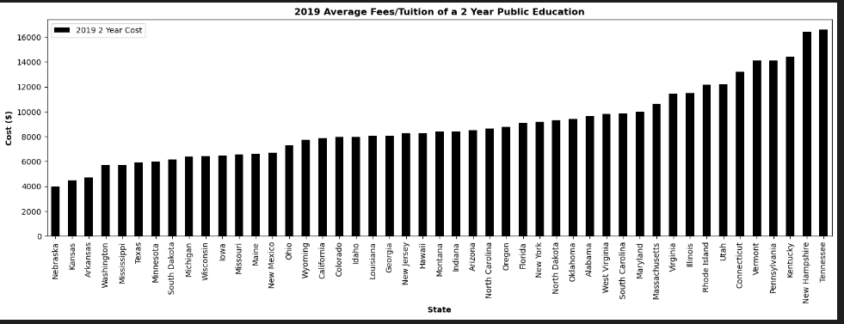
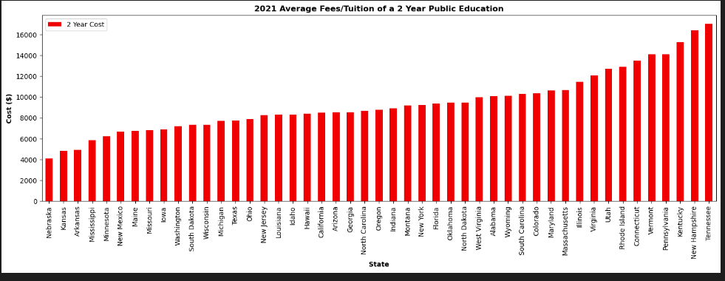
Analysis:

Slide 9
Analysis:

Slide 10
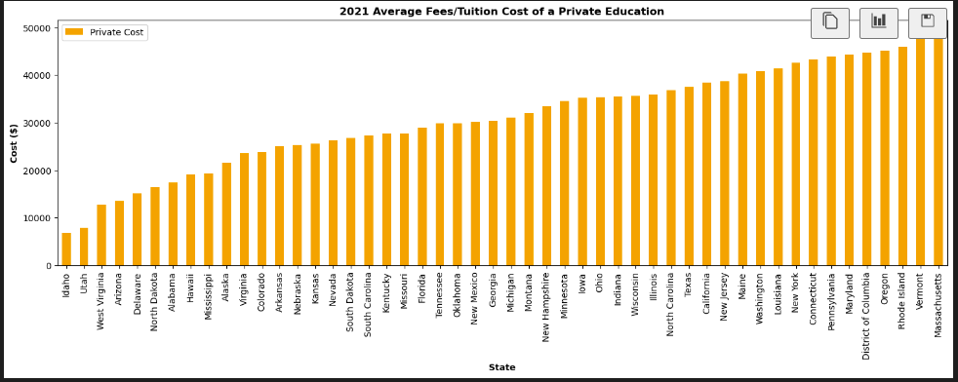
Analysis:

Slide 11
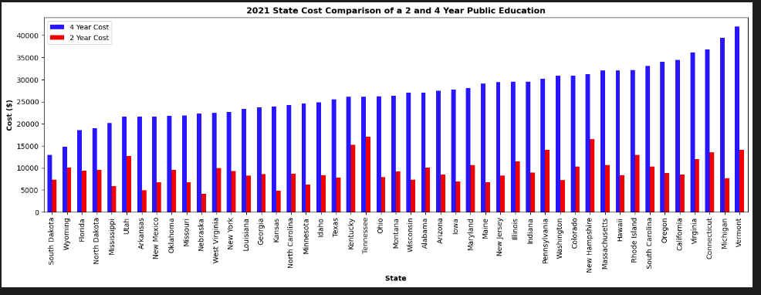
Analysis:

Slide 12
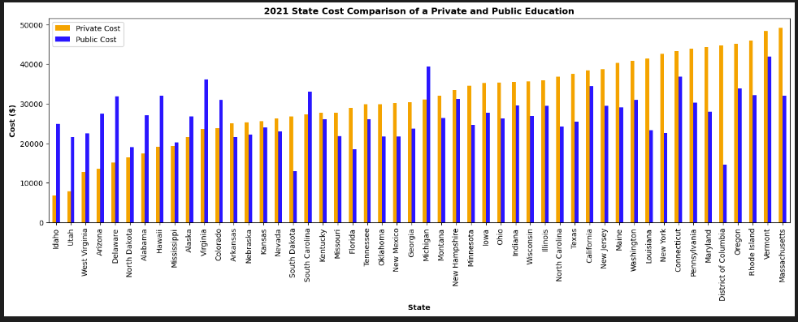
Analysis:

Slide 13
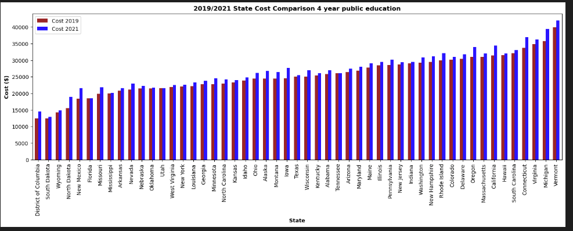
Analysis: COVID Analysis

Slide 14
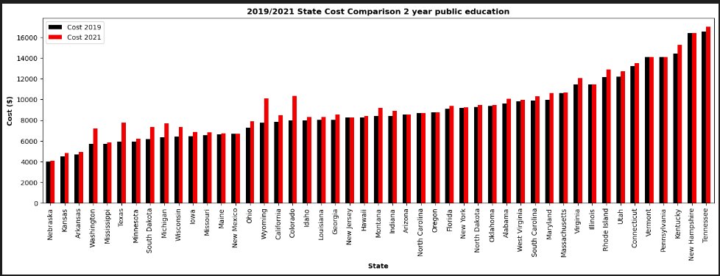
Analysis:

Slide 15
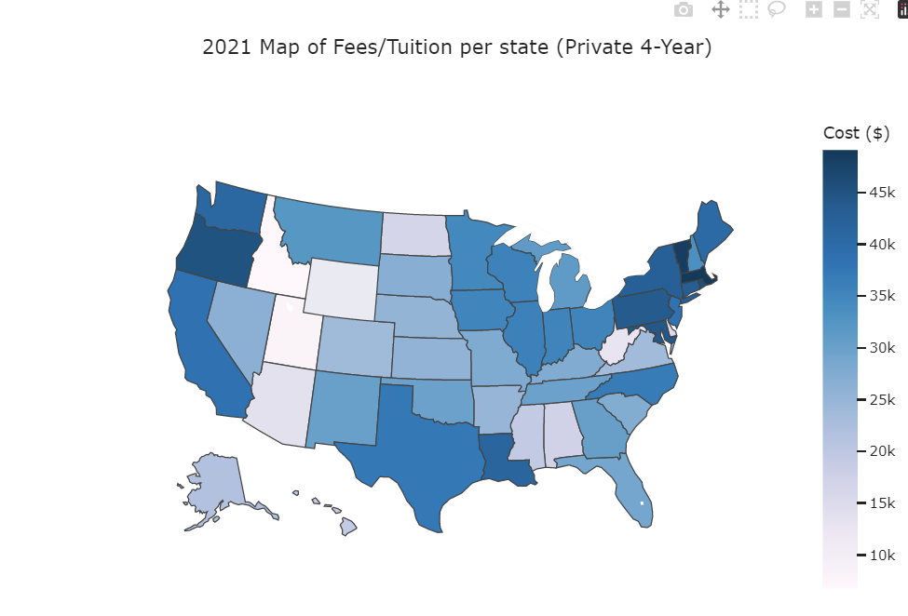
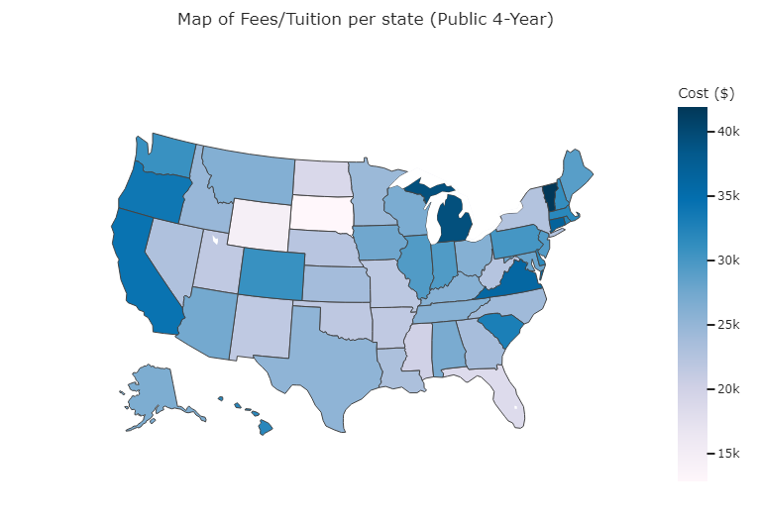

Slide 17
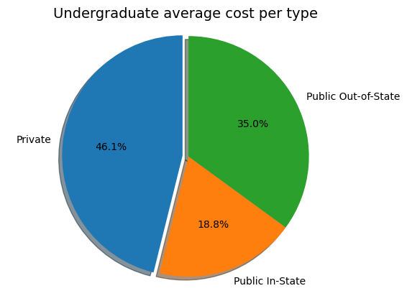
Analysis:

Slide 18
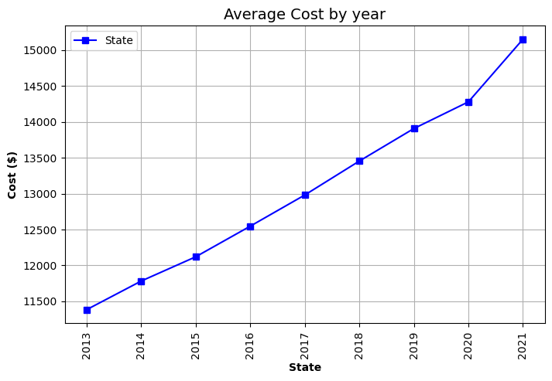
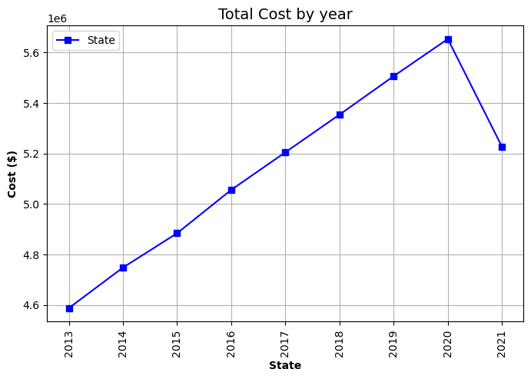
Analysis:
*** may need to look at the Sum Data for accuracy or its correct and need to look at some of the other data to see if it jives.

Slide 19
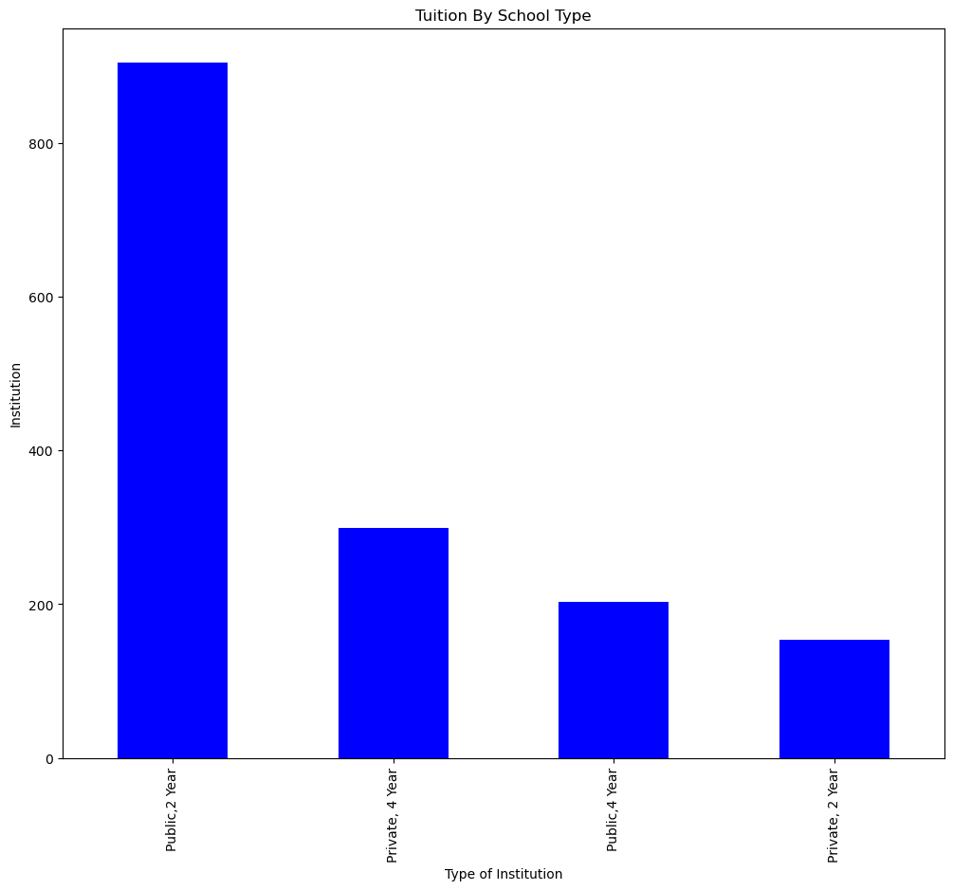
Analysis:
** may want to increase the font size on these to match up the the other plots.

Slide 20
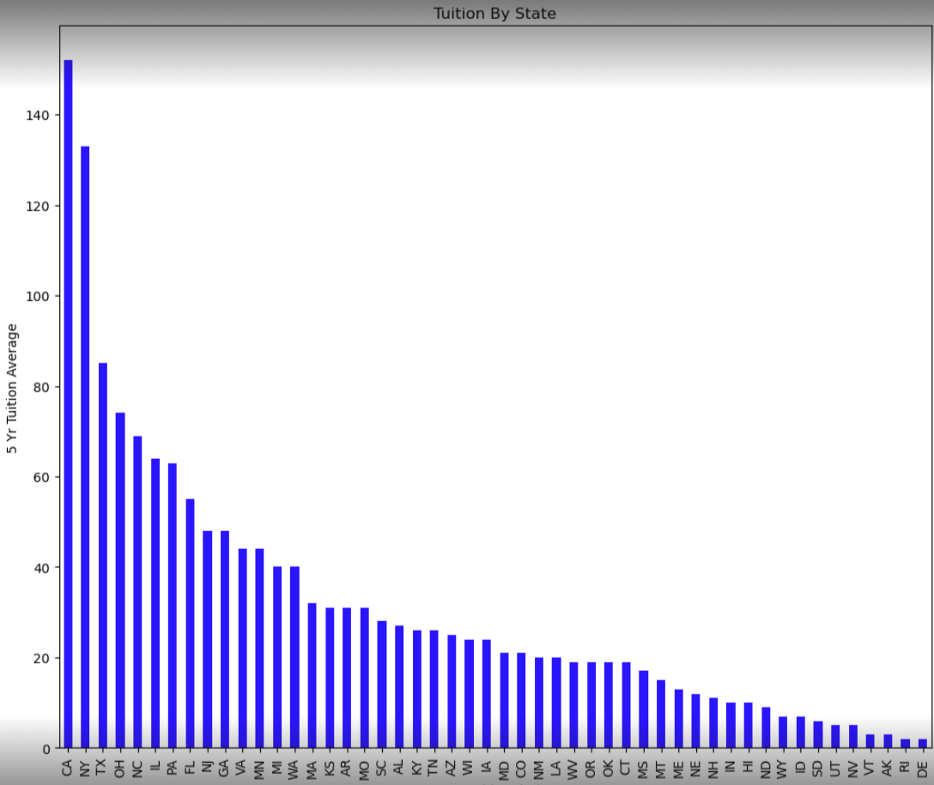
Analysis: Based on the data from NCES on all US 2 year and 4 year only, undergraduate institutions, California and New York are the two highest average annual tuition states by a large margin.

Slide 21
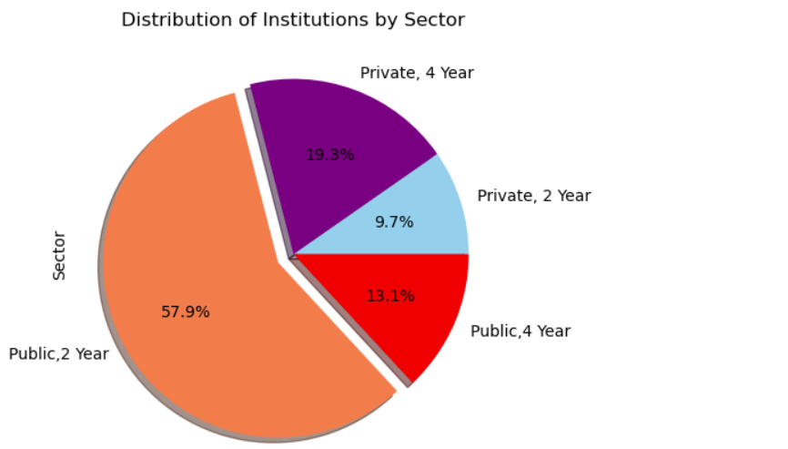
Analysis: 57.9% of US undergraduate only schools [two-year schools (community colleges and county colleges) and four-year colleges] are public, 2 year.

Slide 22
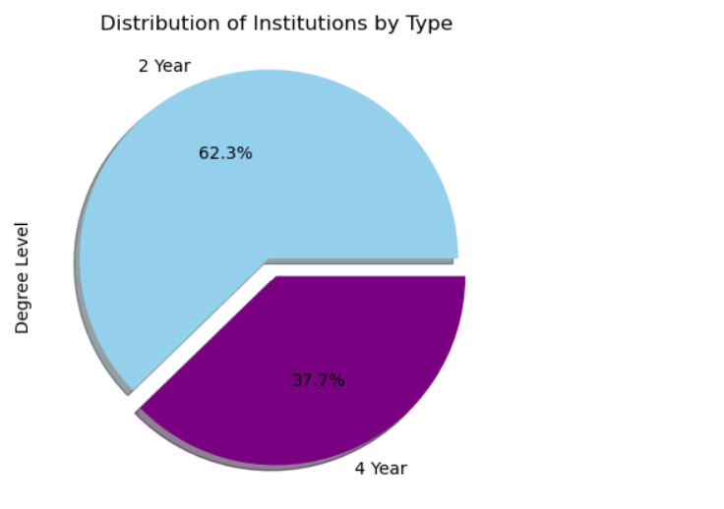
Analysis: 62.3% of US undergraduate only schools [two-year schools (community colleges and county colleges) and four-year colleges] are 2 year.

Slide 23
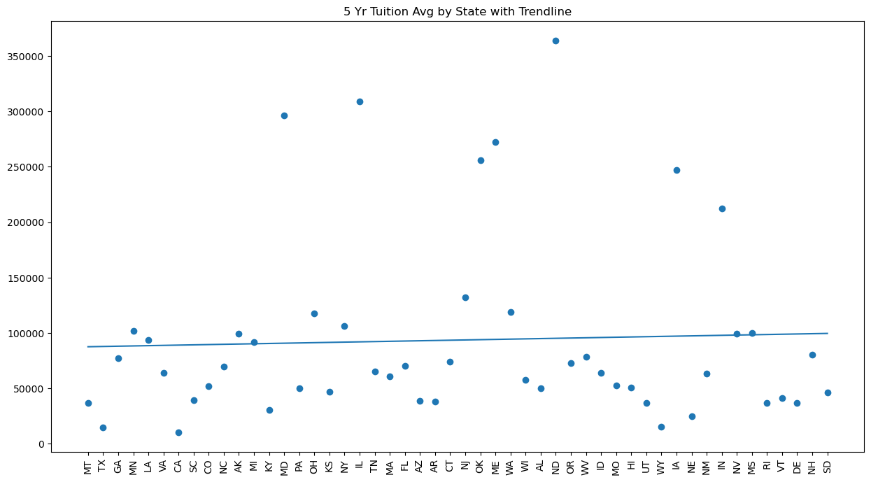
Analysis:
The 5 year annual tuition average of 2 year and 4 year undergraduate only colleges over all 50 states shows a slightly positive trendline.

Slide 24
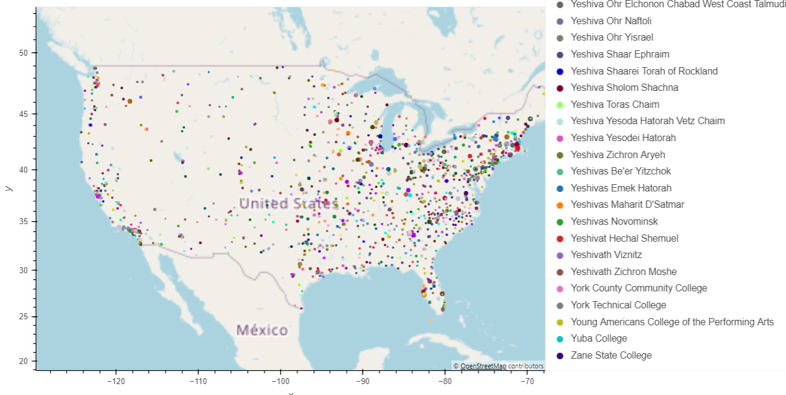
Analysis:
Map showing distribution/location of 2 year and 4 year undergraduate only colleges across the USA. Interesting to see a heavy eastern and southwestern distribution vs a more sparsely populated college presence in the western portion of the mid-west and the northern parts of the US.

Slide 25
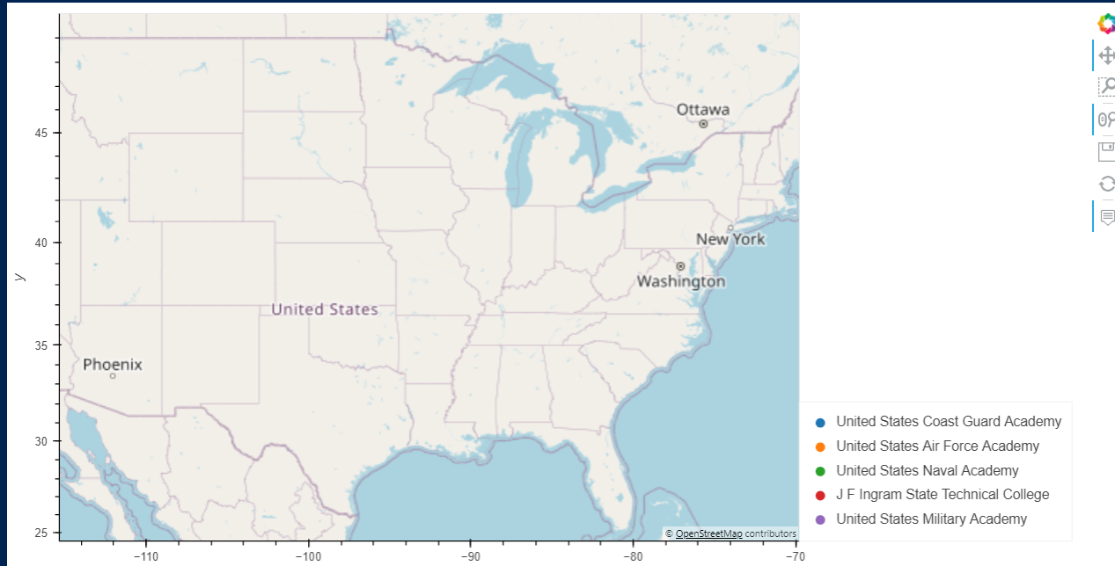
Analysis:
***** Thought this one got redone and we will get the new one.

Slide 26
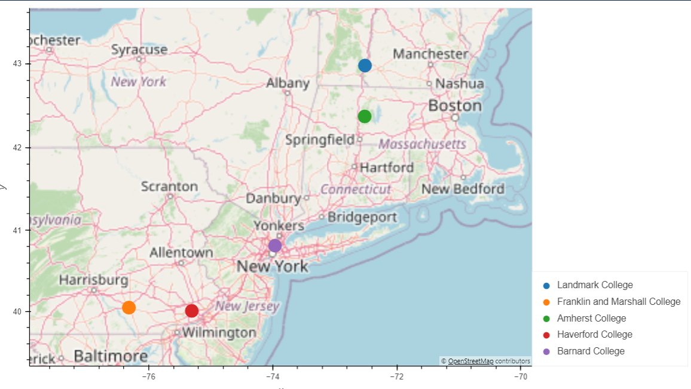
Analysis:
Map showing distribution/location of top 5 highest 5 year tuition average cost in the US. Analysis shows that they are all on the east coast.

Slide 27
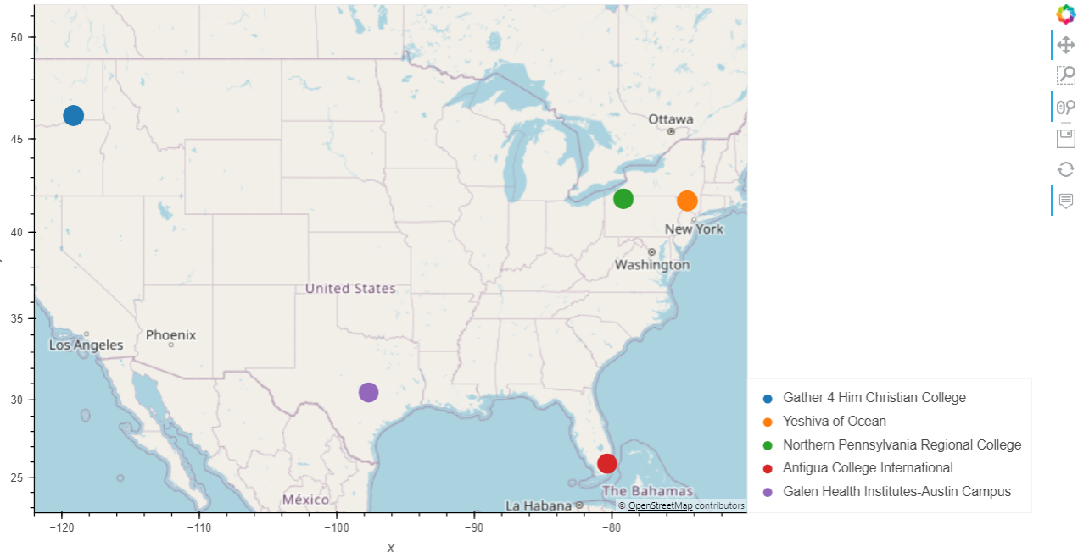
Analysis:
Map showing distribution/location of lowest 5, 5 year tuition average cost 2 year and 4 year undergraduate only colleges in the US. These schools are more distributed within the US than the top 5, but majority still located on the eastern side.

Slide 28
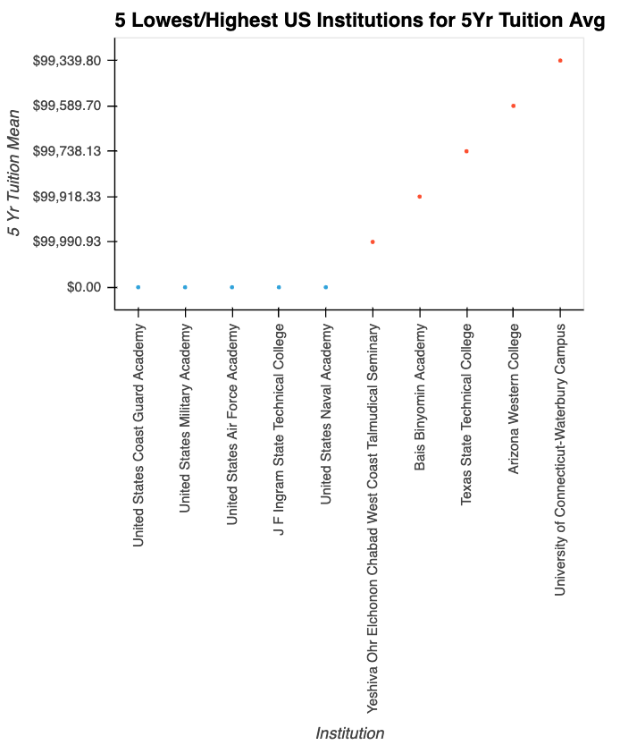
Analysis: Scatterplot displaying the distribution of the lowest 5 schools (2/4 yr based on 5 year average) and the highest 5 schools. The data showing the lowest schools are military academies which are differently funded (therefore $0 tuition data)

Slide 29
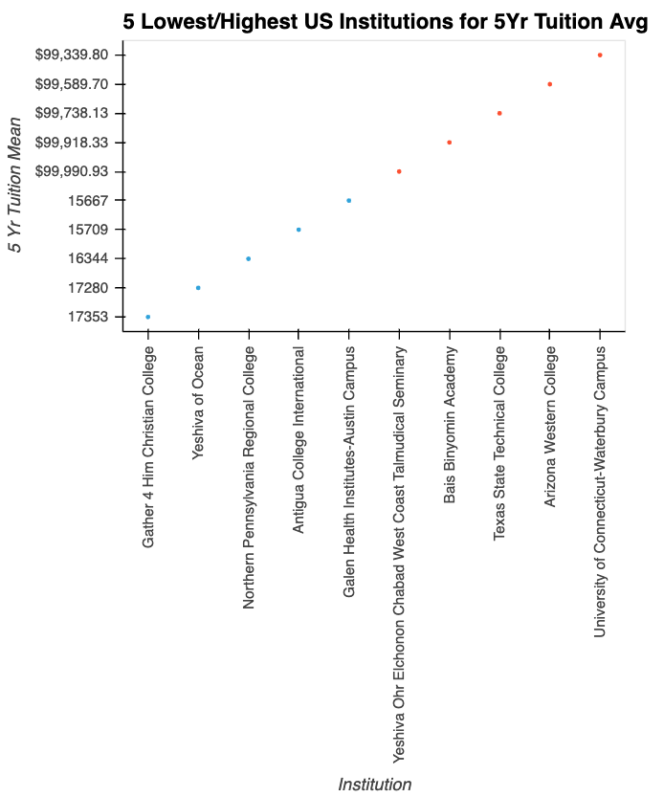
Analysis: Scatterplot displaying the distribution of the lowest 5 schools (2/4 yr based on 5 year tuition average cost) and the highest 5 schools. This provides a visual of the significant annual tuition average difference across the 10 schools overall.

Slide 30
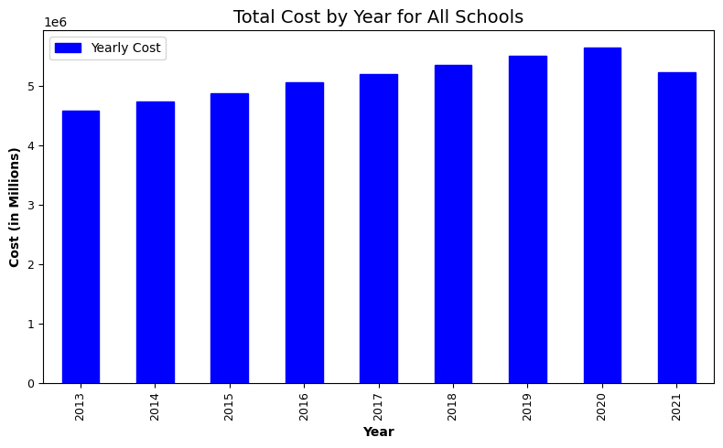
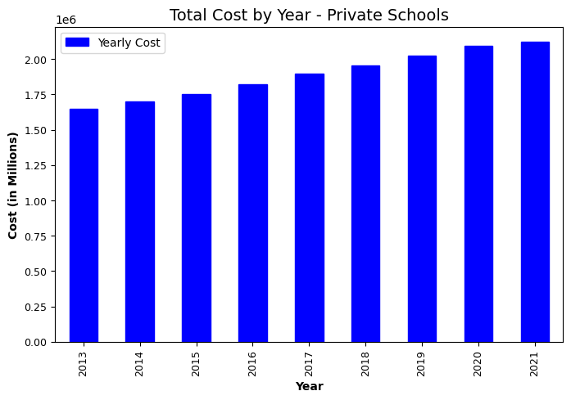
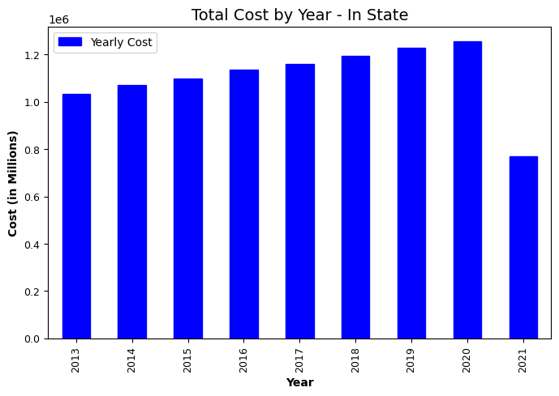
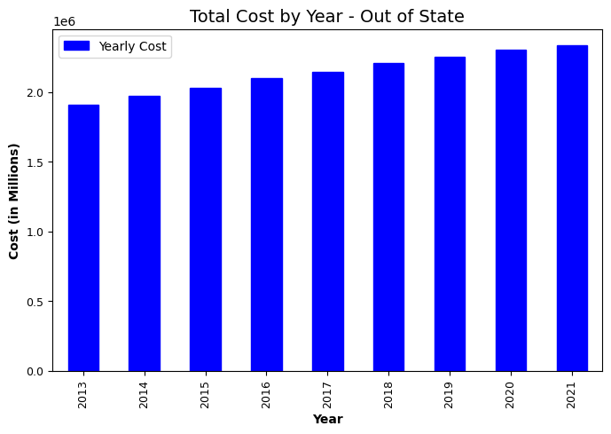
Analysis:

Slide 31
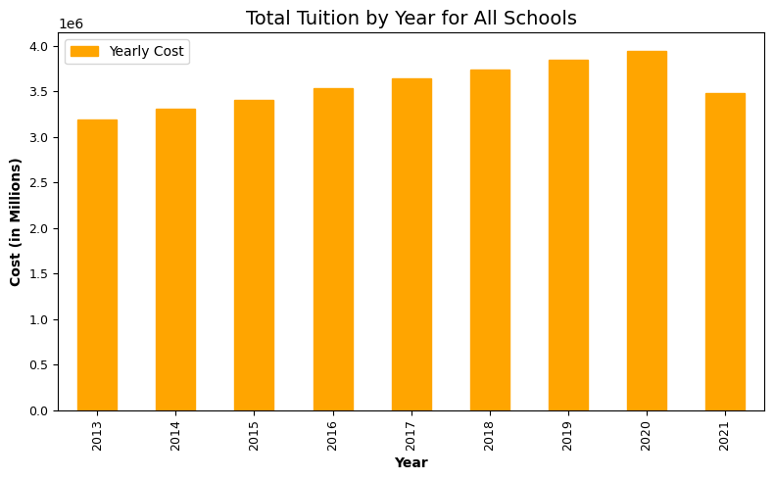
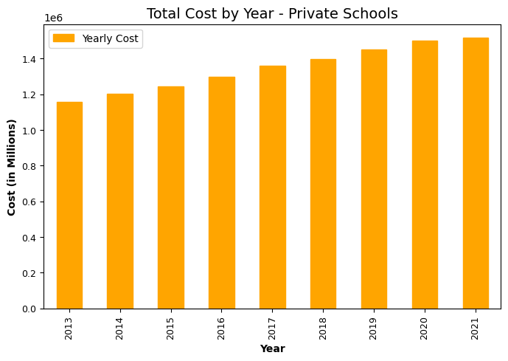
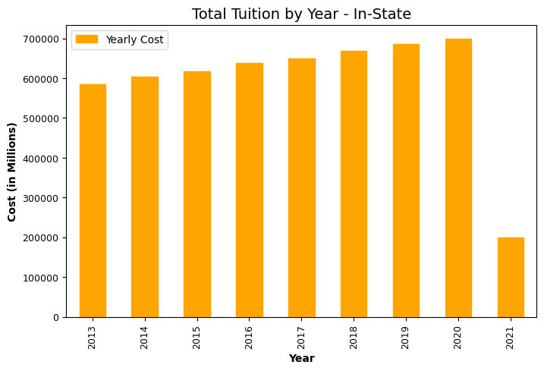
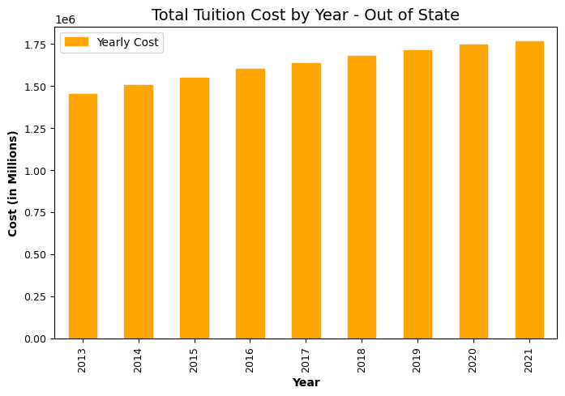
Analysis:

Slide 32
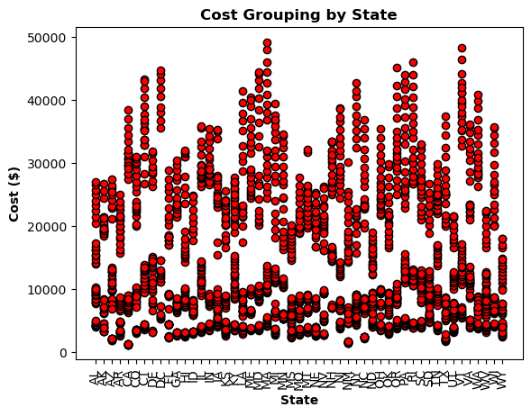
Analysis:
Needs to be redone.

Slide 33
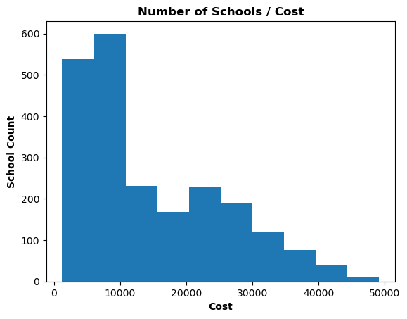
Analysis:
Needs to be redone.

